Slide 1


RTDS-Based Supervisory Control Performance Verification for AC Multiple-Microgrid Systems
  Presenter: Arman Ghasaei
  October 2020

Slide 2
Preface:
  The work in this presentation is part of my Ph.D. dissertation under the supervision of Professor Reza Iravani.
  The RTDS simulation platform used in the work is a property of Center of Applied Power Electronics (CAPE) at University of Toronto.

Slide 3
Outline:
i
Why microgrid? Motivations and challenges?
ii
Multiple-microgrid system? Value proposition?
iii
The hierarchical supervisory control system
iv
Supervisory control performance verification via RTDS-PLCnext platform
Why supervisory control?
Application for first nation communities in North-West Ontario
1

Slide 4
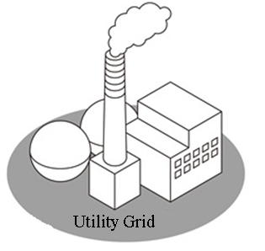
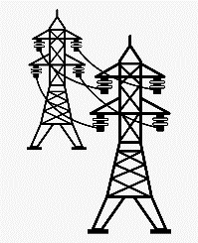






Motivations
Supervisory control system
Performance verification
Multiple-microgrid system
Legacy distribution power system is changing:
* Renewables (intermittent generations)
* EV stations (intermittent loads)
No coordination anti-islanding policies!
Microgrid:
Autonomy of operation from the utility
Key component: storage system (fast, bi-directional, dispatchable)
Transmission
line
E? P?
Storage system
EV charging
stations
Renewable energies
Industrial loads
Residential loads
Distribution system
2
Microgrid

Slide 5



Motivations
Supervisory control system
Performance verification
Multiple-microgrid system
Intelligence (supervisory control):
Energy trading
Emergency power provision (more reliability)
Islanded operation (more resiliency)
It is all about a functional supervisory control system!
Intelligence
(Supervisory Control)
SCADA
commands (CMD)
Transmission
line
measurements
$
P
$
E
Microgrid
P-Q
V-f
SOC
Storage system
EV charging
stations
Renewable energies
Industrial loads
local control
Residential loads
local control
local control
local control
CMD
CMD
CMD
CMD
CMD
3
CMD

Slide 6





Motivations
Supervisory control system
Performance verification
Multiple-microgrid system
: SOC? operational?
: sunny? cloudy?
: Windy?
: EV #?
(2 operation condition)/(component):
131072 possible scenarios for supervisory control to cover!
4

Slide 7
Motivations
Supervisory control system
Performance verification
Multiple-microgrid system
Envisioned Modes of Operation
CB_{m} | Closed | Grid-connected
 | Open | Islanded
CB_{i,(i=1,2,3,4)} | Closed | Grid-connected MG or islanded multiple-microgrid system
 | Open | Islanded single-microgrid
Three independently
controlled grid-connected MGs
Islanded
Three-Microgrid System
5
Islanded Single-Microgrid System

Slide 8
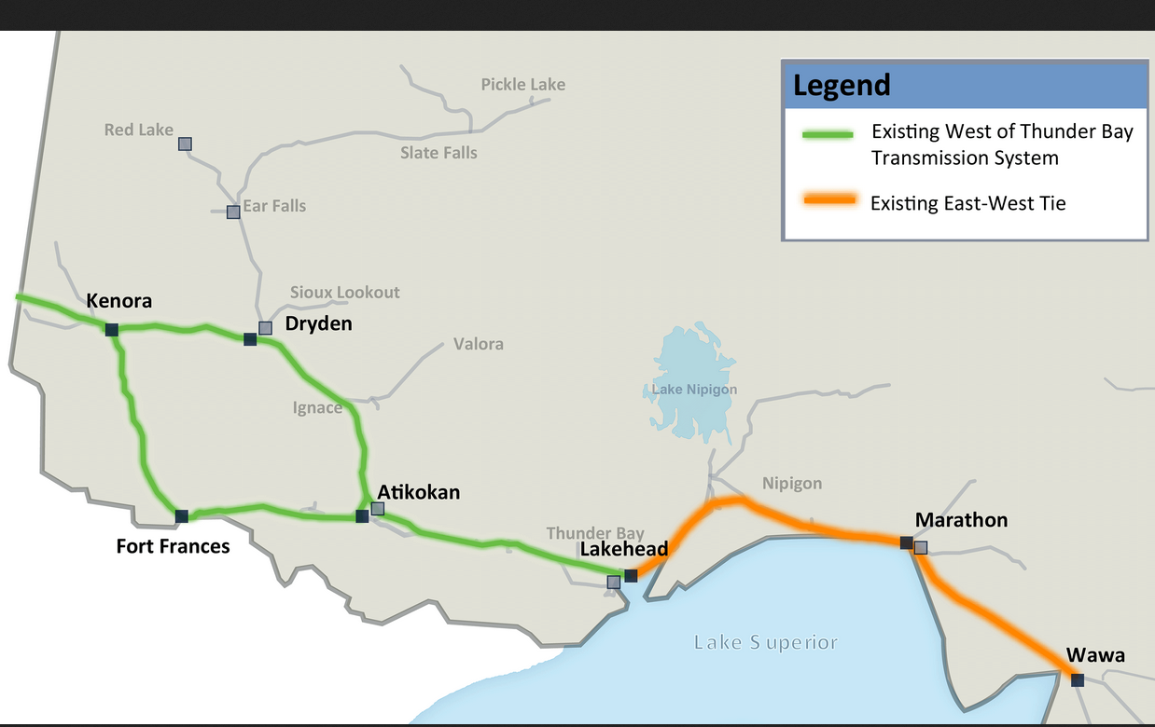
Motivations
Supervisory control system
Performance verification
Multiple-microgrid system
Northwest Ontario Bulk Planning Initiative (IESO-Hydro One-Next Bridge)
Remote generation 9-10 times higher cost vs provincial generation
($1.14/kWh VS $0.12/kWh)
Source: (OPA)
475 MW capacity increase
Source: (IESO)
Anticipated cost reduction:
1.5 B $/year!
Existing West of Thunder Bay Transmission System
Existing East-West Tie
New 230 kV lines
Source: IESO
6

Slide 9
Motivations
Supervisory control system
Performance verification
Multiple-microgrid system
First nation community sub-systems:
Source: Agoracom.com
7

Slide 10
Motivations
Supervisory control system
Performance verification
Multiple-microgrid system
Value proposition:
1) Benefit from clean energy
2) Energy trading with utility
2) Emergency energy support
3) Enhanced security of supply
$
P
$
E
$
E
$
P
$
P
$
E
$
E
$
P
Islanded Three-Microgrid
System
Islanded Four-Microgrid
System
8
Islanded Single-Microgrid System

Slide 11
Motivations
Supervisory control system
Performance verification
Multiple-microgrid system
Does the SC system provide a trivial task?
Multi-microgrid components
#4 | 13 MW 13 MWh
#12 | 20 MW Replacing each 5 MW diesel-fuel saves 20 M$/year
#2 | 12 MW ONLY BAKCUP
 | Average: 17 MW Peak: 31.9 MW
9

Slide 12
Motivations
Supervisory control system
Performance verification
Multiple-microgrid system
Complexity of operation?
For this system of 5 CBs
32 possible CB configurations
All should be covered by the SC system!
10

Slide 13
Motivations
Supervisory control system
Performance verification
Multiple-microgrid system
Within each MG:
coordination
SC System
11

Slide 14
Motivations
Supervisory control system
Performance verification
Multiple-microgrid system
Two-layer Hirarchical SC system:
SC: Supervisory Control
CB: Circuit-Breaker
MG: microgrid
CMD: command
MMT: measurement
12

Slide 15
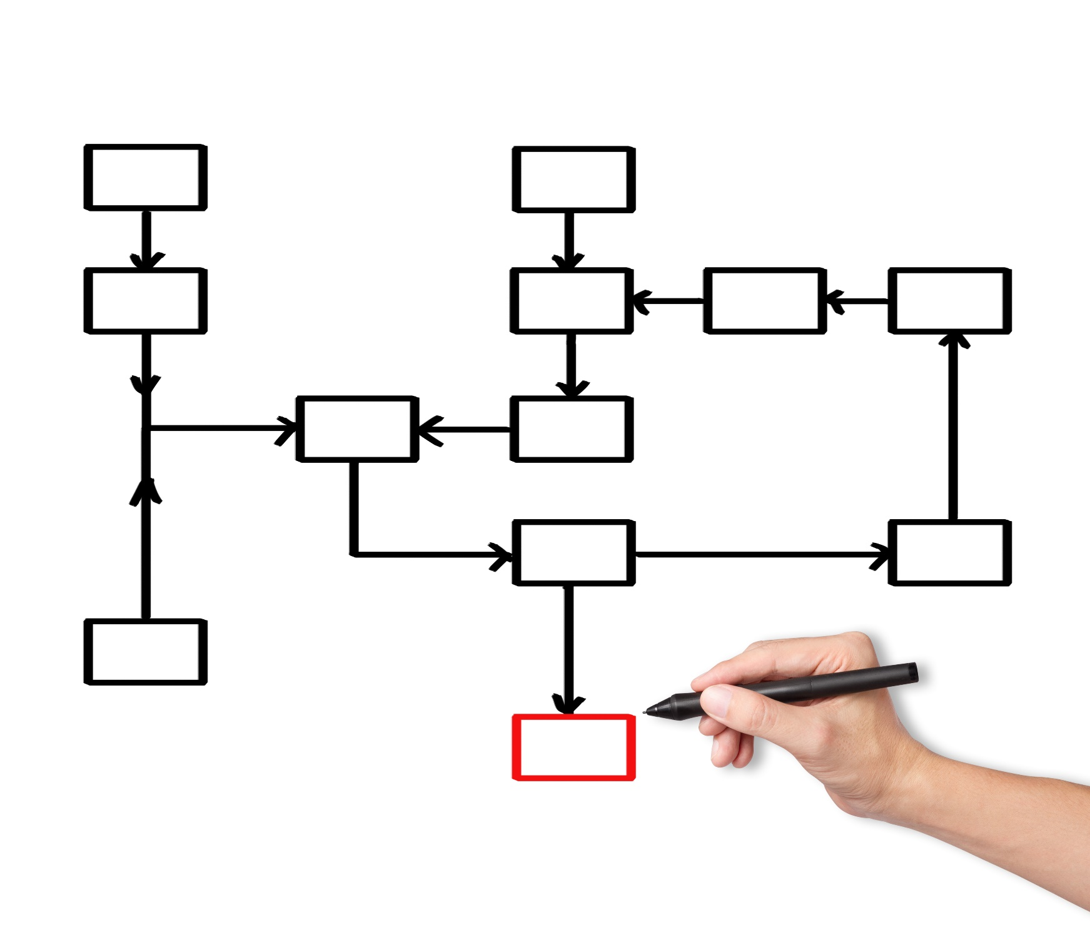
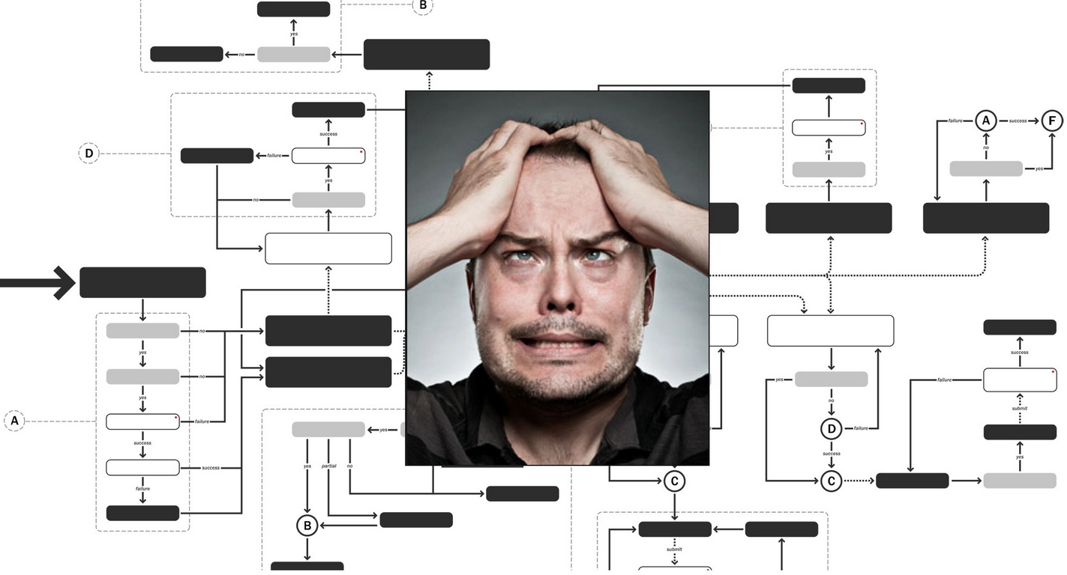
Motivations
Supervisory control system
Performance verification
Multiple-microgrid system
Existing methods for SC
Heuristic-based development! All scenarios?
Solution for each scenario?
Non-blocking?
Scalable?
Large-scaled systems?
Multiple flow-charts and confliction!?
Not automated!
?
?
?
?
?
?
?
?
?
?
?
?
13
Source: https://www.reddit.com/r/witcher/comments/396om2/can_someone_make_a_flow_chart_of_the_characters/

Slide 16
Motivations
Supervisory control system
Performance verification
Multiple-microgrid system
Supervisory Control Theory (SCT)
Systematic development
Guaranteed to covers all possible scenarios
In case of an event: provides an operation solution
Non-blocking
Non-conflicting
Scalable
Automated solution!
14

Slide 17
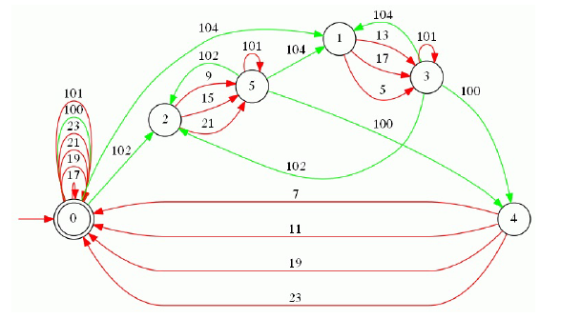
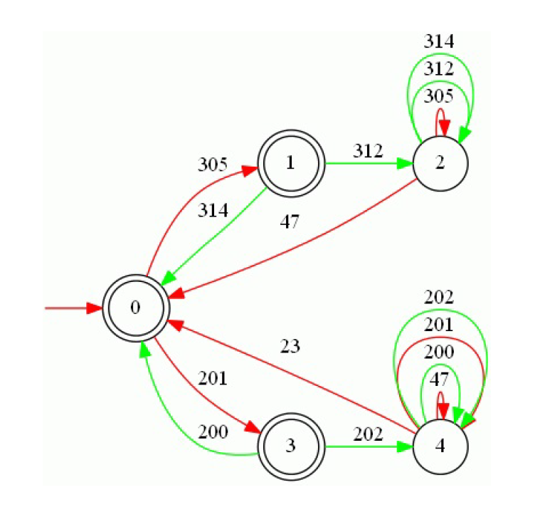
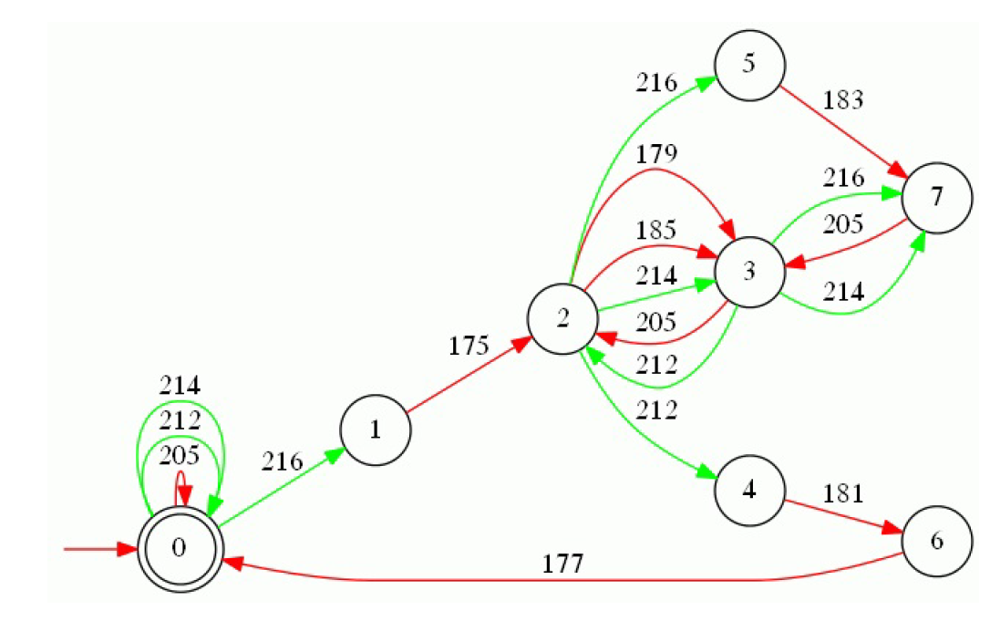


Motivations
Supervisory control system
Performance verification
Multiple-microgrid system
SCT-based SC System
Multiple-Microgrid Model
non-blocking
48 decentralized
supervisors
SCT-based design tool
non-conflicting
non-conflicting
non-blocking
non-blocking
Proposed Control
Strategy
SOC
P-Q
V-f
Storage system
15
non-conflicting

Slide 18
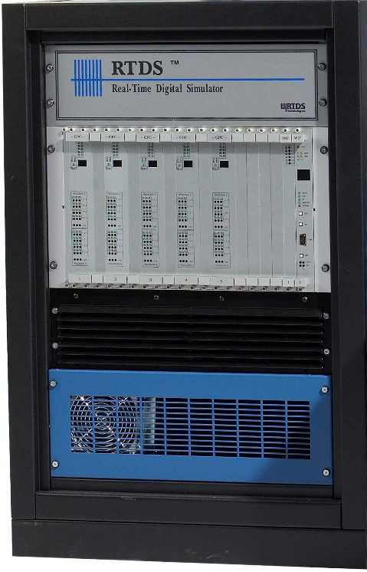
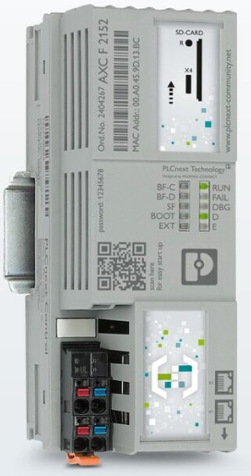
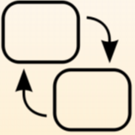
Motivations
Supervisory control system
Performance verification
Multiple-microgrid system
Supervisory control design
Off-line evaluation
Real-time verification
Field test
Verification of PLCnext performance?
MMT
MATLAB
–
Stateflow
PSCAD
/
EMTDC
Multiple microgrid
and local control
CMD
Supervisory control
RTDS
PLCNext
MMT
HIL
Multiple microgrid
and local control
CMD
SC
algorithm
16

Slide 19
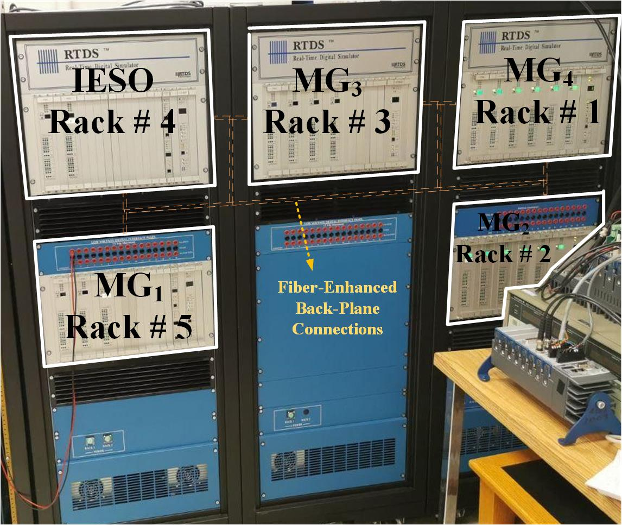
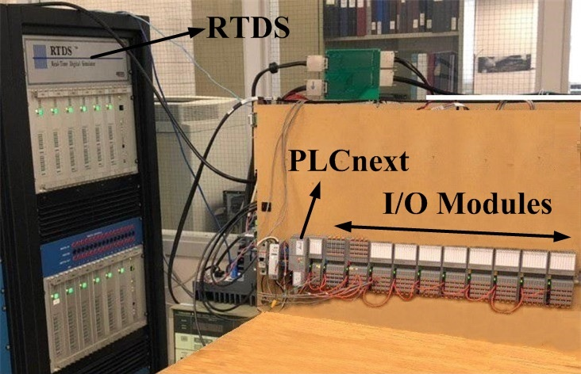
Motivations
Supervisory control system
Performance verification
Multiple-microgrid system
Real-time simulation of roughly 600 electrical nodes and 18 distributed resource
Δt = 80 us
HIL
17

Slide 20
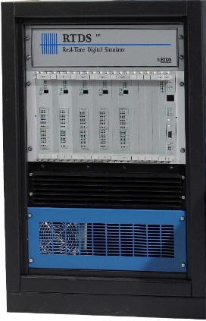
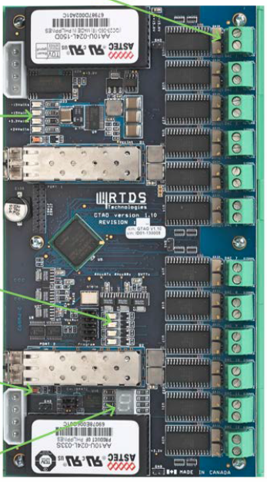
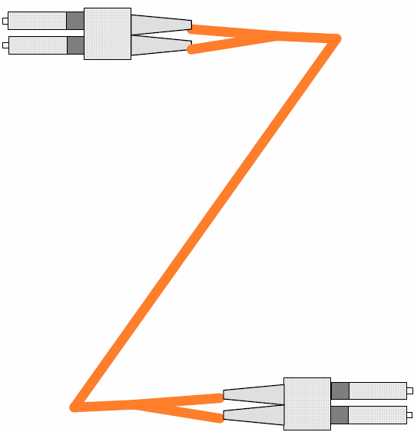
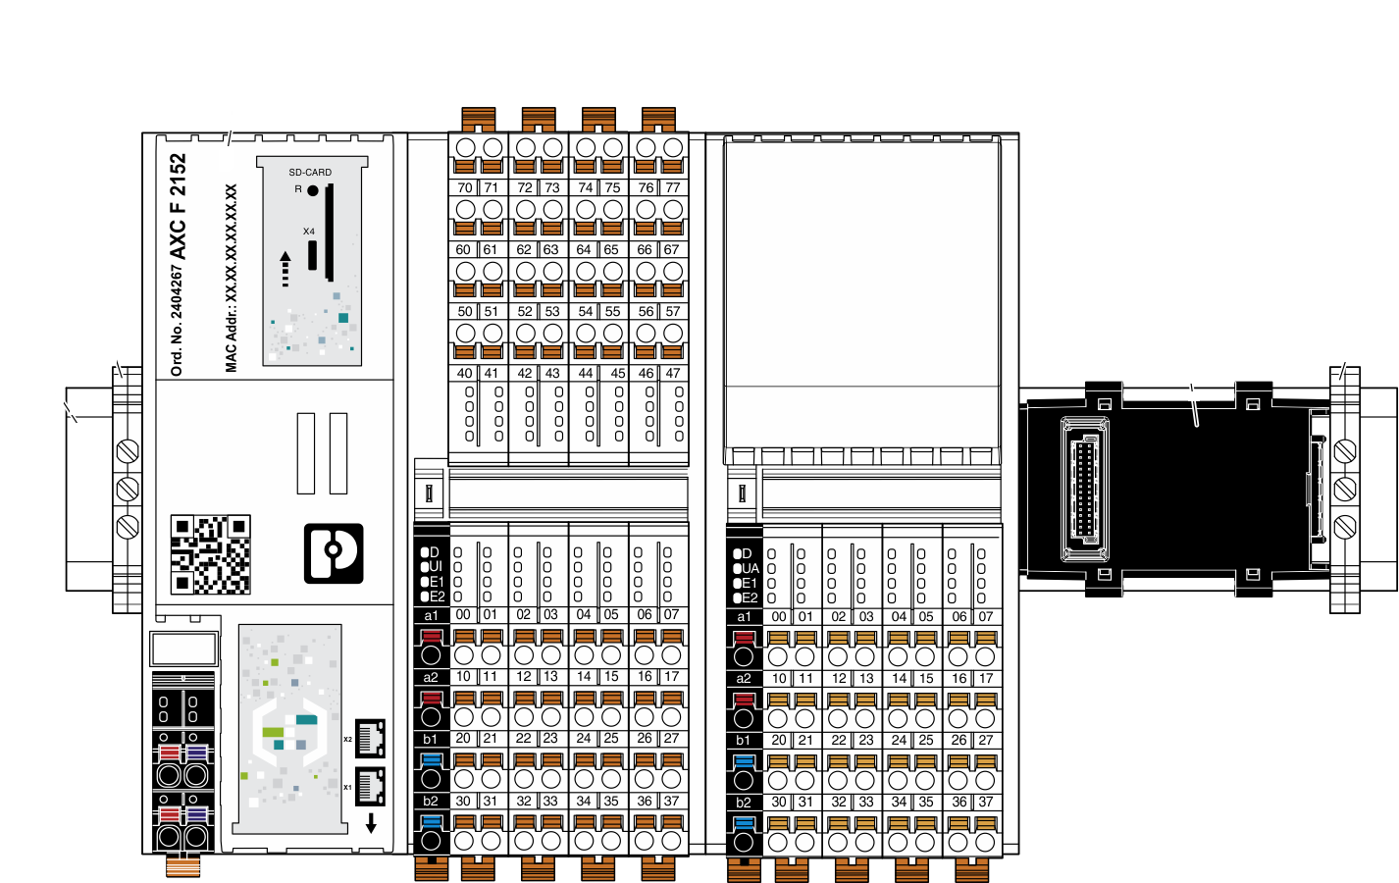
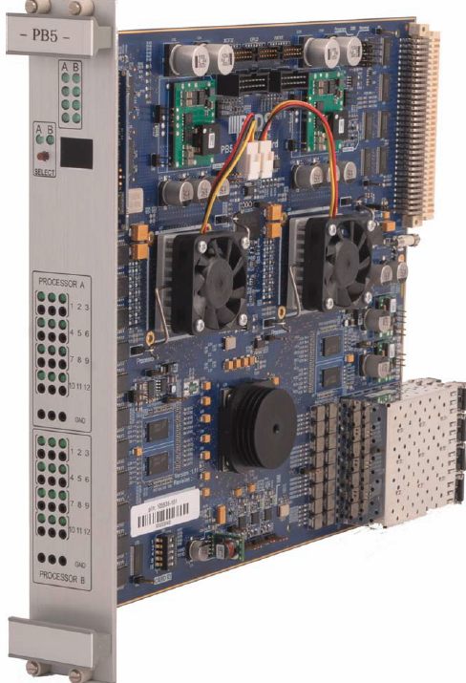
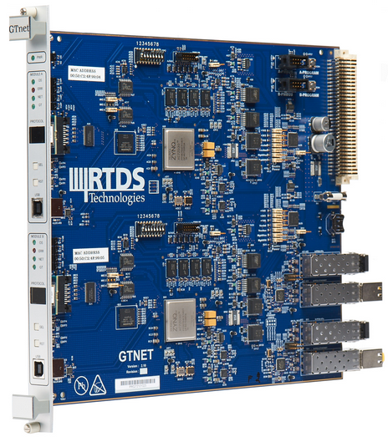

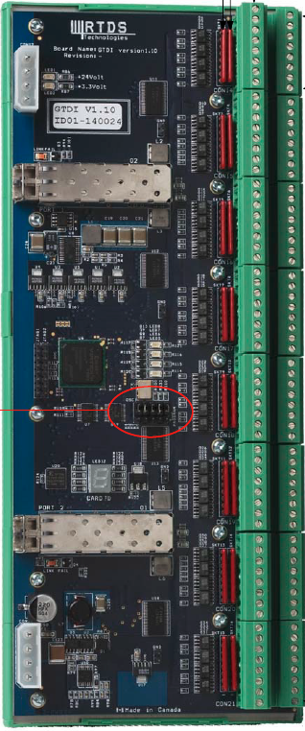
Motivations
Supervisory control system
Performance verification
Multiple-microgrid system
HIL
RTDS (80 us)
Analog to PLCnext # 26
Analog Cards
Analog to RTDS # 4
(1 ms) PLCNext
Fiber Connection
PB5 # 19
Digital Modules
GTNET Card
Analog Modules
MODBUS-TCP
Digital Cards
Source: https://www.phoenixcontact.com/online/portal/ca?1dmy&urile=wcm:path:/caen/web/home
Digital to RTDS # 31
Digital to PLCnext # 5
18
https://www.rtd.com/manuals.htm

Slide 21
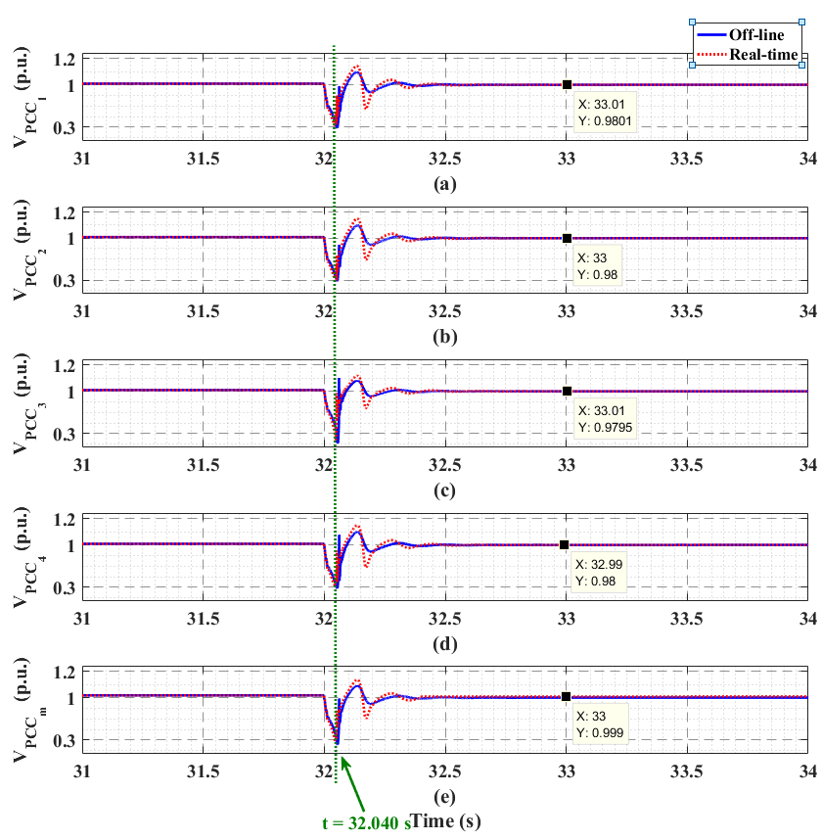
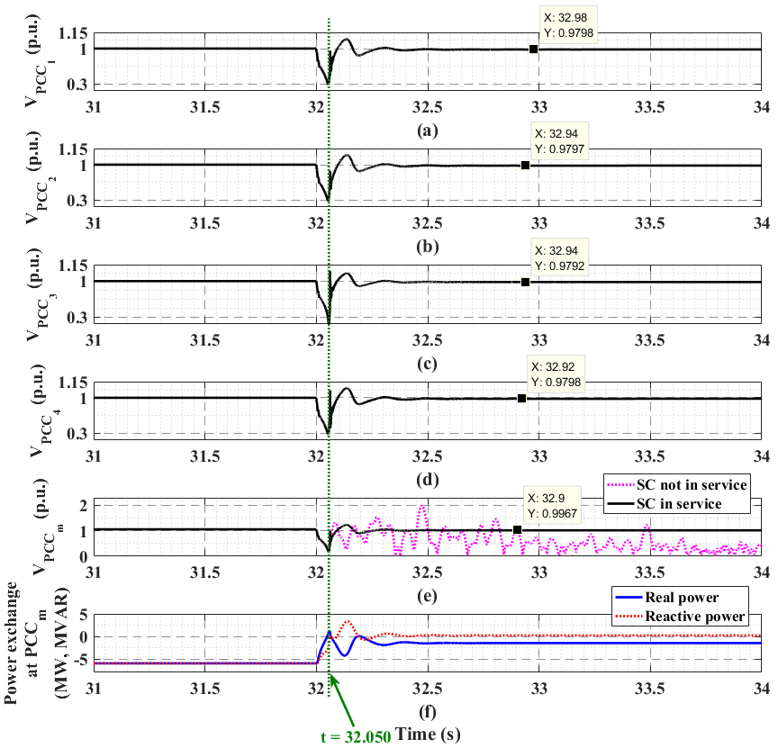
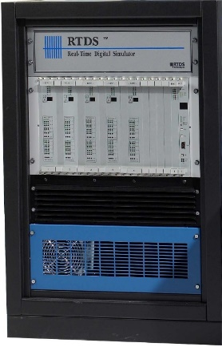
Voltage support function
P₁,V_{ref1}
P₃,V_{ref3}
P₂,V_{ref2}
P₄,V_{ref4}
T = 32.050 s
T = 32.030 s
T = 32.041 s
T = 32.000 s
T = 32.031 s
T = 32.040 s
P,Q request
P
Q
V_{PCCm}
SCR = 12.2
cmd
cmd
SCR = 0.1
cmd
cmd
Complying with IEEE-1547 standard
19

Slide 22

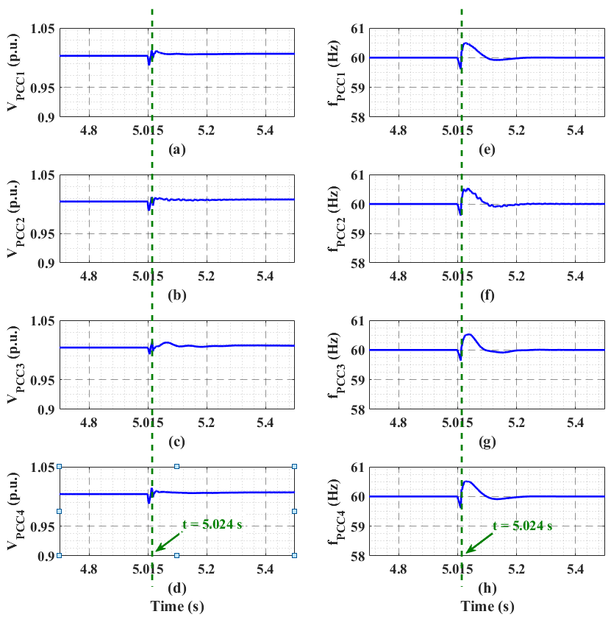
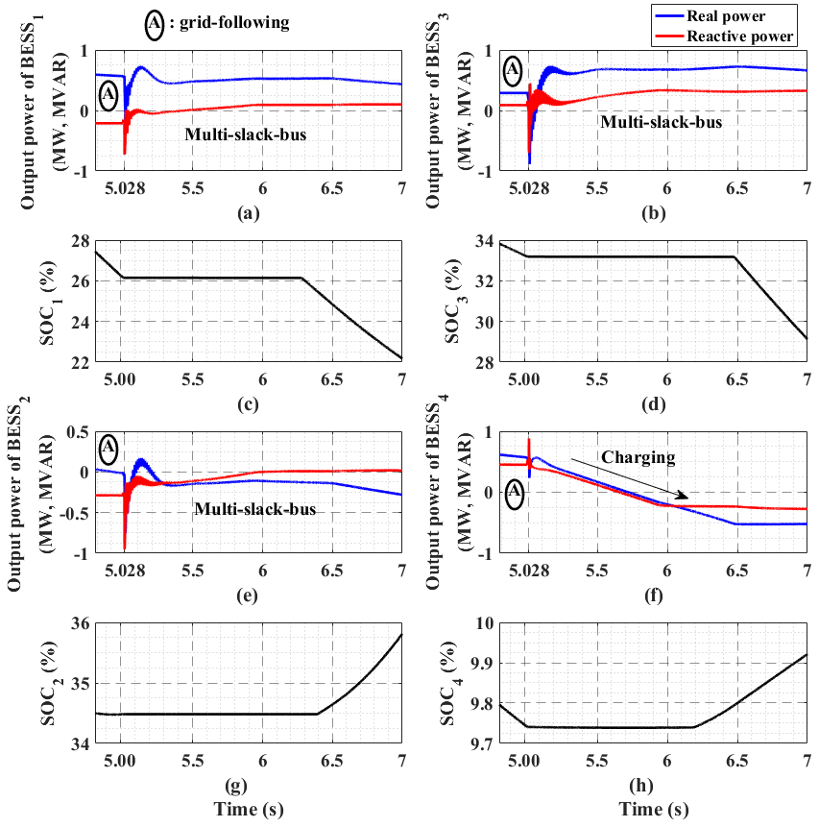
Intentional islanding
T = 5.027 s
T = 5.024 s
T = 5.020 s
T = 5.012 s
T = 5.011 s
T = 5.026 s
T = 5.025 s
T = 5.021 s
T = 5.028 s
T = 5.022 s
T = 5.024s
T = 5.023 s
T = 5.021 s
T = 5.011 s
T = 5.028 s
T = 5.026 s
T = 5.020 s
T = 5.023 s
T = 5.012 s
T = 5.027 s
T = 5.025 s
T = 5.022 s
SC_{m}
CB_{m}-opening
Grid-forming cmd
Grid-forming cmd
Grid-forming cmd
Grid-forming cmd
State1
State2
State3
State4
SC₁
SC₂
SC₃
SC₄
Open CB_{m}
cmd
cmd
cmd
cmd
PCC₁
PCC₂
PCC₃
PCC₄
SOC1
SOC2
SOC3
SOC4
Complying with IEEE-1547 standard
20

Slide 23
Q&A
E-mail: arman.ghasaei@mail.utoronto.ca

